Slide 1



Noida Institute of Engineering and Technology, Greater Noida
Semiconductor Diode and its Applications
Unit: 4
Basic Electrical and Electronics Engineering
Amit Tripathi
(EN Department)
B.Tech 1st/2nd Sem

Slide 2
Content
Introduction to Semiconductors: Intrinsic and Extrinsic
P-N Junction Diode
Depletion Layer
V-I Characteristic
Application of Diodes
Half and Full wave Rectification
Clippers and numerical Problem
Breakdown Mechanism: Zener and Avalanche
Zener Diode as shunt regulator
Display Devices
Liquid Crystal Display (LCD)
Light Emitting Diode (LED) AND Organic-LED (O-LED)
Seven Segment Display

Slide 3
Course Objective
The course objectives are:
To Provide concept for the analysis of basic DC and AC (Single phase and Three phase) electrical circuits.
To study the concept of transformer, calculate its efficiency and to impart elementary knowledge of power system components, Earthing and energy consumption.
To understand the concept and application of diode, display devices, Op-Amp, sensors and IoT.
.

Slide 4
Course Outcome
On completion of the course, students will be able to:
1 | CO1 | Apply the concepts of KVL/KCL and network theorems in solving DC circuits.
2 | CO2 | Analyze the steady state behavior of single phase and three phase AC electrical circuits.
3 | CO3 | Illustrate and analyze the working principle of a single phase transformer, efficiency, and components of Power system, Earthing and energy calculation.
4 | CO4 | Understand the concept and applications of PN junction diode and Display devices.
5 | CO5 | Understand the concept of Op-Amps, Digital multimeter, Sensors and application of IoT.

Slide 5
CO-PO Mapping
 | PO1 | PO2 | PO3 | PO4 | PO5 | PO6 | PO7 | PO8 | PO9 | PO10 | PO11 | PO12
CO1 | 3 | 3 | 1 | 2 | - | - | - | - | 1 | 1 | 1 | 2
CO2 | 3 | 3 | 1 | 2 | - | - | - | - | 1 | 1 | 1 | 2
CO3 | 3 | 2 | 2 | 1 | - | - | - | - | 1 | 1 | 1 | 2
CO4 | 3 | 2 | 1 | 2 | - | - | - | - | 1 | 1 | 1 | 2
CO5 | 3 | 1 | 1 | - | - | - | 1 | 1 | 1 | 1 | 1 | 2

Slide 6
CO-PSO Mapping
 | PSO1 | PSO2 | PSO3
CO1 | 2 | 1 | 1
CO2 | 2 | 1 | 1
CO3 | 2 | 1 | 1
CO4 | 2 | - | 1
CO5 | 2 | - | 1

Slide 7
Prerequisite
Students should have the knowledge of :
Atomic Structure, Energy Band, Valence Band, Conduction Band) and elements of periodic table (Group-3 & Group-5)
Basic electrical terms such as- Current, Voltage and Resistance etc.

Slide 8
Introduction to Semiconductors
Name of Topic | Duration (Lectures) | (%) Assignment coverage | % of marks in exams
Semiconductor Materials, Depletion Layer, Barrier Potential | 1 | 20 | 5

Slide 9
Introduction
Q: What is Electronics Engineering?
Ans: The technology associated with low voltage, current and semiconductor solid state integrated circuits, usually for transmission or processing of analog or digital data.
OR
It is a field of science and engineering, which deals with electronic devices and their utilization.
Q: What is Electronic Device?
Ans: A device in which conduction takes place by the movement of electrons through a vacuum, gas or a semiconductor.

Slide 10
Atomic Structure
Energy Band: The range of energies possessed by an electron in a solid.
There are two energy bands in solids:
1. Valence Band: The range of energies possessed by valence electrons.
2. Conduction Band: The range of energies possessed by free electrons (conduction electrons).

Slide 11
Comparison of Si, Ge and GaAs semiconductors
Semiconductor | Intrinsic Carriers (n_{i} in per cubic centimeter) | Band Gap (E_{g} in eV) | Electron Mobility (μ_{n} in cm²/V-s)
Si | 1.5 x 10¹⁰ | 1.1 | 1500
Ge | 2.5 x 10¹³ | 0.67 | 3900
GaAs | 1.7 x 10⁶ | 1.43 | 8500
Note: Semiconductor materials have
Negative Temperature Coefficient

Slide 12

Carriers in Semiconductor
Ec
18º^{K}
17º^{K}
20º^{K}
11º^{K}
Eg
14º^{K}
15º^{K}
12º^{K}
13º^{K}
16º^{K}
4º^{K}
1º^{K}
2º^{K}
0º^{K}
3º^{K}
19º^{K}
10º^{K}
5º^{K}
6º^{K}
7º^{K}
8º^{K}
9º^{K}
300º^{K}
Ev
Electron Hole Pair
E
H
P

Slide 13
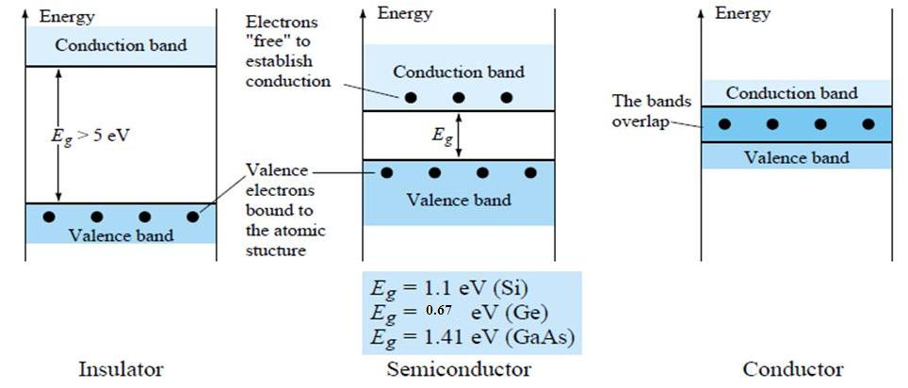
Classification of Solids
The energy diagram for the three types of solids are:
1. Insulator e.g. C, wood, plastic etc.
2. Semiconductor e.g. Si, Ge etc.
3. Metal (Conductor) e.g. Cu, Al, Au etc.
Notes:
131313

Slide 14
Semiconductors in extremely pure form
Type of Semiconductors
1. Intrinsic (pure) Semiconductor
e⁻
Si
E_{g}
h⁺
n=p=n_{i}

Slide 15
2. Extrinsic Semiconductor (P & N Type)
In order to increase conductivity of intrinsic semiconductor we have add some impurity to the intrinsic semiconductor. The resultant is know as extrinsic type semiconductor.
Doping: Adding of impurities (dopants) to the intrinsic semi-conductor material.
P-type: Adding Group III dopant (or acceptor) such as B, Al, Ga, In …
N-type: Adding Group V dopant (or donor) such as As, P, Sb, Bi …
e⁻
Sb
h⁺
Al
Si

Slide 16
Carriers in Extrinsic Semiconductor (P-Type)
Ш Group
B
Al
Ga
In
Ec
50º^{K}
18º^{K}
11º^{K}
14º^{K}
15º^{K}
20º^{K}
19º^{K}
12º^{K}
13º^{K}
17º^{K}
16º^{K}
4º^{K}
1º^{K}
2º^{K}
0º^{K}
3º^{K}
10º^{K}
5º^{K}
6º^{K}
7º^{K}
8º^{K}
9º^{K}
Ea
Ev
Acceptor

Slide 17
Carriers in Extrinsic Semiconductor (N Type)
V Group
P
As
Sb
Ec
Ed
50º^{K}
18º^{K}
11º^{K}
14º^{K}
15º^{K}
20º^{K}
19º^{K}
12º^{K}
13º^{K}
17º^{K}
16º^{K}
4º^{K}
1º^{K}
2º^{K}
0º^{K}
3º^{K}
10º^{K}
5º^{K}
6º^{K}
7º^{K}
8º^{K}
9º^{K}
Ev
Donor

Slide 18
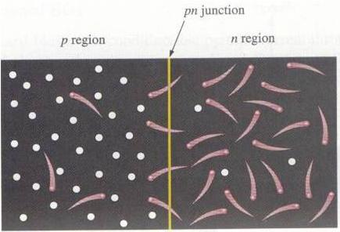
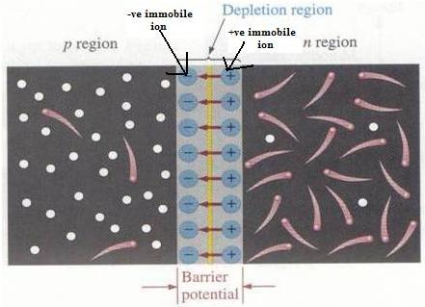
PN-Junction, Formation of depletion region & Barrier potential
The interface in-between p-type and n-type material is called a pn-junction.
Fig. (a)
Fig. (b)

Slide 19

Daily Quiz
The potential difference across the p-n junction is called…………
(Barrier potential)
The physical distance from one side to other side of depletion region is called……… of depletion region.
(width)
The barrier potential of silicon diode is about ……volts.
(0.7)

Slide 20
Weekly Assignment
Short Answer type Questions:
Q.1) Explain the effect of temperature on conductivity of semiconductor.
Q.2) Why extrinsic semiconductors are better than intrinsic ?
Long Answer type Questions:
Q.3) Explain n-type extrinsic conductor with example and proper diagram.

Slide 21
Multiple Choice Questions
Q.1) A semiconductor is formed by …… bonds. Covalent Electrovalent Co-ordinate None of the abpve | Q.4) When a pentavalent impurity is added to a pure semiconductor, it becomes…… An insulator An intrinsic semiconductor p-type semiconductor n-type semiconductor
Q.2) A semiconductor has …… temperature coefficient of resistance. Positive Zero Negative None of the above | Q.5) Addition of pentavalent impurity to a semiconductor creates many…… Free electrons Holes Valence Electrons Bound Electrons
Q.3) A semiconductor generally has .….. Valence electrons- 2 3 4 6 | Q.6) A trivalent impurity has …… valence electrons 4 5 6 3

Slide 22

Questions from Previous Papers
1. Why Si is preferred over Ge? (2015-16)
2. Explain the Intrinsic and Extrinsic semiconductors. (2014-15)
3. Explain the term impurity and doping. (2012-13)
4. Explain the formation of Depletion layer along with barrier potential and effect of temperature on barrier potential. (2010-11, 2012-13)
5. Define barrier potential. (2010-11)

Slide 23
Expected Questions for University Exam
Q.1) Compare the properties of Si and Ge semiconductors.
Q.2) Differentiate between intrinsic and extrinsic semiconductors

Slide 24
Recap
“Electronics Engineering” is a field of science and engineering, which deals with electronic devices and their utilization.
“Electronic Device” is the device in which conduction takes place by the movement of electrons through a vacuum, gas or a semiconductor (S/C).
“Valence Band” The range of energies possessed by valence electrons.
“Conduction Band” The range of energies possessed by free electrons.
The three types of solids are: 1. Insulator 2. Semiconductor 3. Conductor.
Intrinsic (pure) Semiconductor means; which is in extremely pure form.
Doping: adding of impurities (dopants) to the intrinsic semi-conductor material.
Extrinsic (impure) Semiconductor means; which is in impure form.
P-type: adding Group III dopant (acceptor) such as B, Al, Ga, In.
N-type: adding Group V dopant (donor) such as As, P, Sb, Bi.
The interface in-between p-type and n-type material is called a pn-junction.

Slide 25
P-N Junction Diode
Name of Topic | Duration (Lectures) | (%) Assignment coverage | % of marks in exams
V-I Characteristics of Diodes (Ideal and Practical) | 1 | 20 | 5

Slide 26
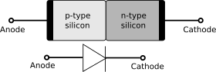
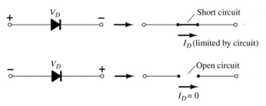
Symbol of a p-n junction Diode
No movement of charge carriers through a p-n junction at equilibrium.
A diode ideally conducts in only one direction

Slide 27
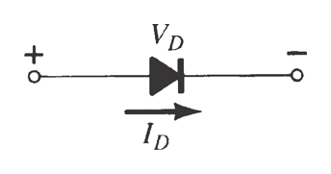
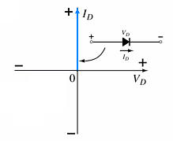
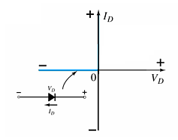
Ideal Diode Characteristics
Conduction Region
Non-Conduction Region
The voltage across the diode is 0V (means V_{B} = 0 V).
Thus, the current is infinite.
Now, diode acts like a short switch.
All of the voltage is across the diode.
Thus, the current is 0 A.
The diode acts like open switch.

Slide 28
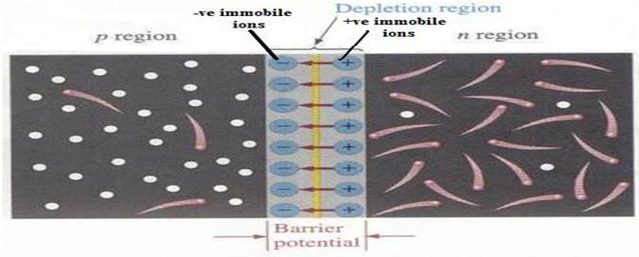
Diodes – Basic Diode Concepts
Biasing the PN-Junction
Forward Bias: dc voltage positive terminal connected to the p region and negative to the n region. Here, V_{BIAS} (V_{F} ) = V_{B}

Slide 29
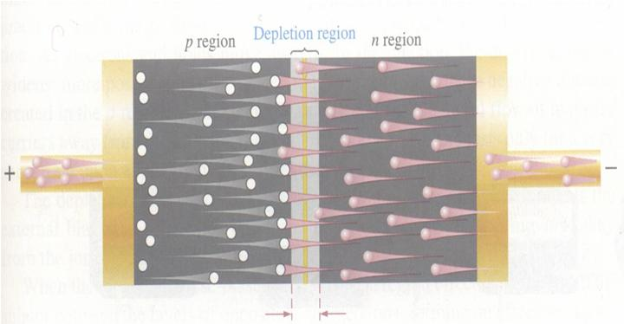
Biasing the PN-Junction
Forward Bias: dc voltage positive terminal connected to the p region and negative to the n region.
if V_{BIAS} (V_{F} ) ≥ V_{B}
then width of depletion region decreases.

Slide 30
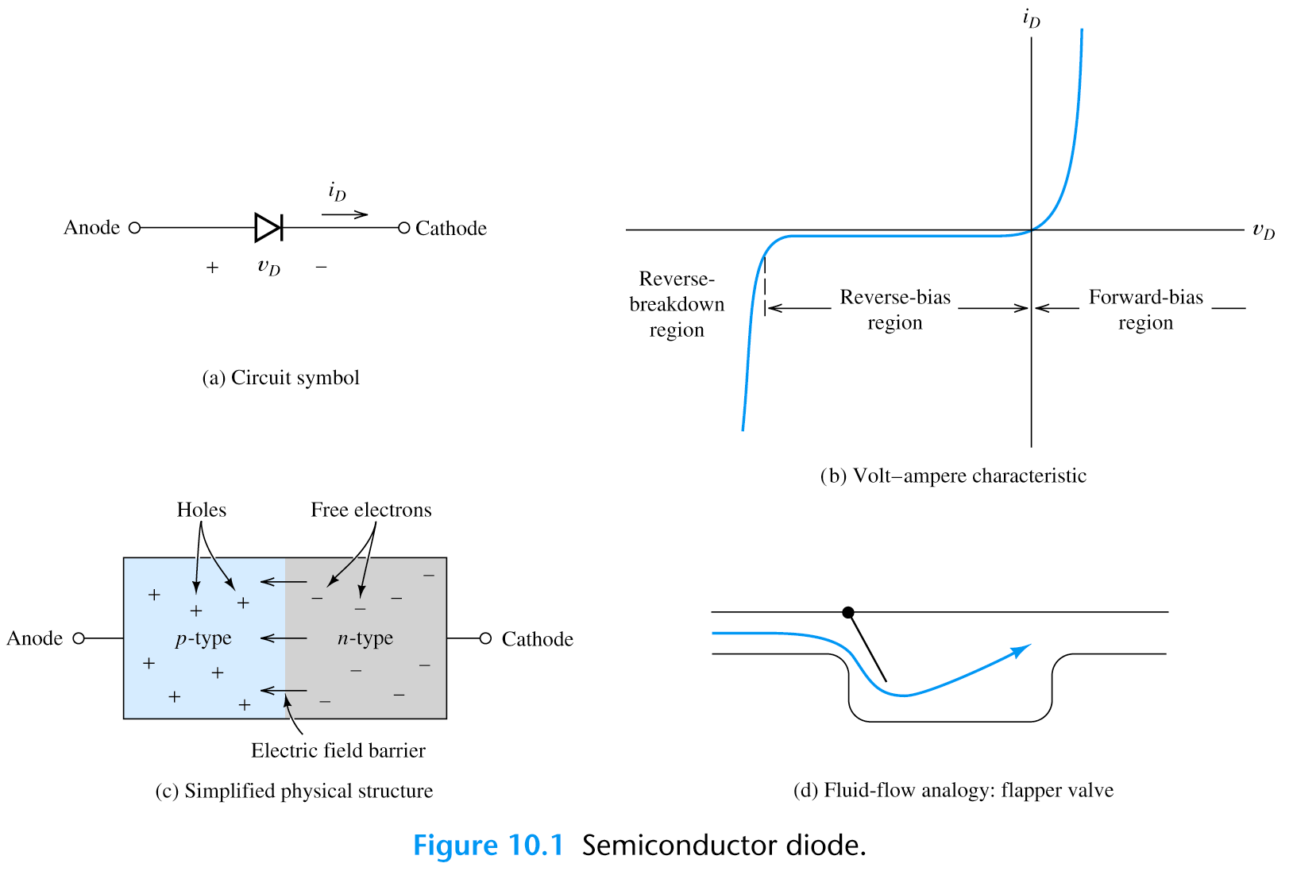
Diodes – Basic Diode Concepts
Biasing the PN-Junction
Forward Bias (practical V-I characteristics):

Slide 31
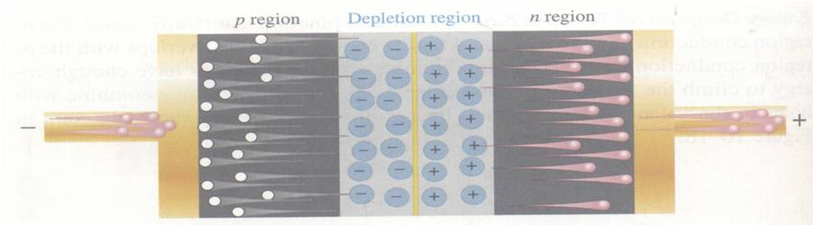
Diodes – Basic Diode Concepts
Diodes – Basic Diode Concepts
Reverse Bias: dc voltage negative terminal connected to the p region and positive to the n region. Depletion region widens until its potential difference equals the bias voltage, majority-carrier current ceases.

Slide 32
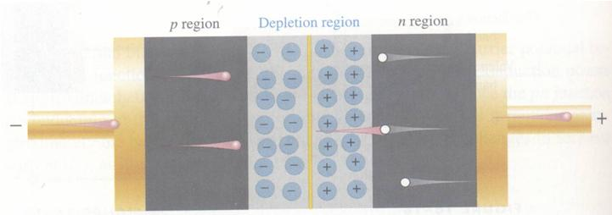
Diodes – Basic Diode Concepts
Reverse Bias (practical V-I characteristics):
majority-carrier current ceases.
However, there is still a very small current produced by minority carriers known as Reverse Saturation Current.

Slide 33
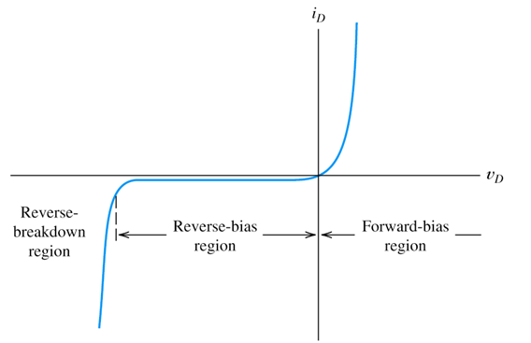
Biasing the PN-Junction
Reverse Breakdown: As reverse voltage reach certain value, avalanche occurs and generates large current.

Slide 34
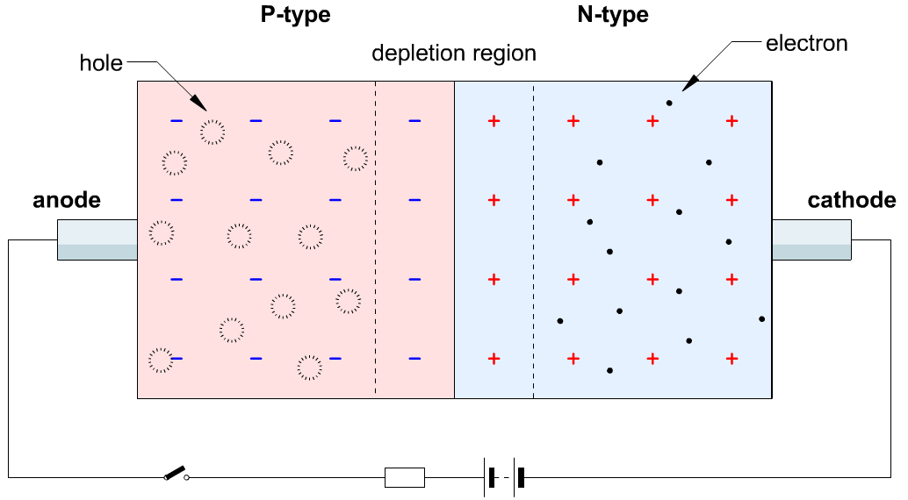
Biasing the PN-Junction (ANIMATION)

Slide 35
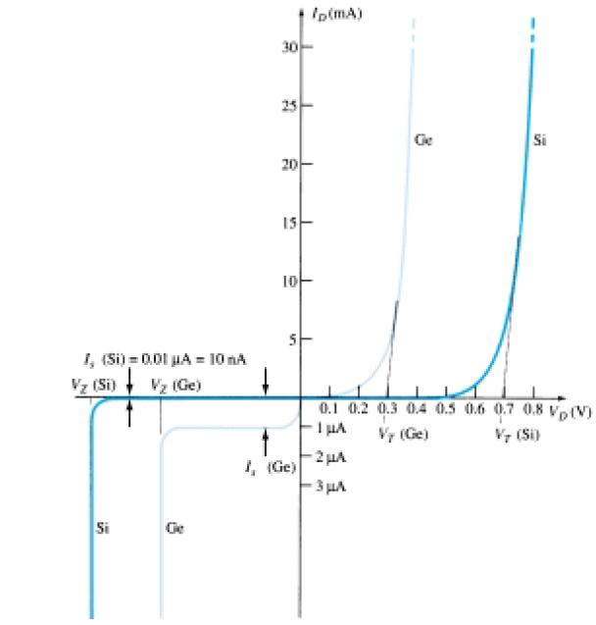
Comparison of Si & Ge semiconductor PN-Junction diode

Slide 36
Diode current equation (Shockley Equation):

Slide 37
Daily Quiz
The device having two electrodes is called………..
(Diode)
The arrowhead in the diode symbol points the direction of ……current.
(Forward)
Due to forward biasing, the depletion region …………….
(Narrows)

Slide 38
Weekly Assignment
Short Answer type Questions:
Q.1) In which biasing, diode acts as open circuit and short circuit?
Long Answer type Questions:
Q.2) Explain formation of depletion layer and also define barrier potential.
Q.3) Draw the V-I characteristics for an ideal and practical diode, also explain knee voltage.

Slide 39
Multiple Choice Questions
Q.1) In a semiconductor current conduction is due to …… Only holes Only free electrons Holes and free electrons None of the above | Q.4) With forward bias to a p-n junction, the width of depletion layer …… Decreases Increases Remains the same None of the above
Q.2) As the doping to a pure semiconductor increases, the bulk resistance of the semiconductor …… Remains the same Increases Decreases None of the above | Q.5) A reverse bias p-n junction has …… Very narrow depletion layer Almost no current Very low resistance Large current flow
Q.3) In an intrinsic semiconductor, the number of free electrons …… Equals the number of holes Is greater than number of holes Is less than number of holes None of the above | Q.6) A forward biased p-n junction diode has a resistance of the order of …… Ω kΩ MΩ None of the above

Slide 40

Questions from Previous Papers
Draw the symbol of p-n junction diode. (2010-11, 2012-13)
Explain knee voltage & its value for Si and Ge diodes. (2006-07)
Draw and explain the V-I characteristics for Ideal and Practical diode. (2009-10)
Write the diode current equation and explain each term.(2005-06, 2010-11)

Slide 41
Expected Questions for University Exam
Q.1) Draw V-I characteristic of p-n junction diode with well labeled diagram.
Q.2) Define depletion layer and barrier potential in a diode.

Slide 42
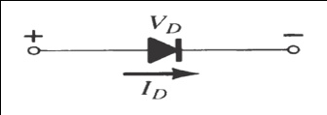
Recap
Diode ideally conducts in only one direction.
In Forward Bias (FB), dc voltage positive terminal connected to the p region and negative to the n region.
In Reverse Bias (RB), dc voltage negative terminal connected to the p region and positive to the n region.
Ideal diode in FB acts like a short switch (zero resistance).
Ideal diode in RB acts like a open switch (infinite resistance).
Practically in RB there is still a very small current produced by minority carriers known as Reverse Saturation Current.
If reverse voltage reach certain value, avalanche occurs and generates large current.
Diode current equation is given as:

Slide 43
Rectifier Circuits
Name of Topic | Duration (Lectures) | (%) Assignment coverage | % of marks in exams
Half & Full Wave Rectification | 2 | 20 | 10

Slide 44
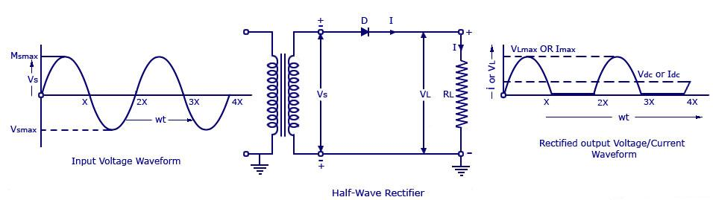
Diodes – Rectifier Circuits
Rectifier Circuits
Rectifiers convert AC voltage to pulsating DC voltage.
Type of Rectifiers:
1. Half-Wave Rectifier: This conducts only during positive half cycles of input ac supply.

Slide 45
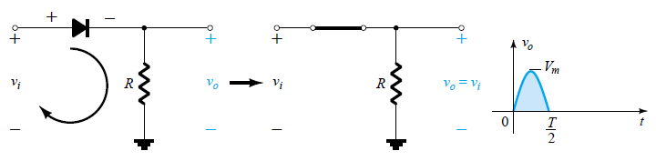
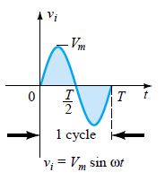
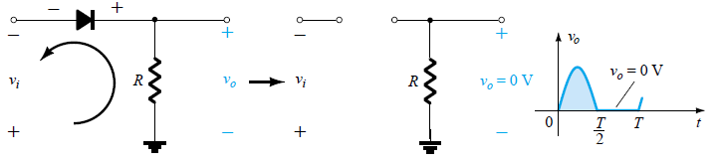
Working of Half-Wave Rectifier:
First (+)ve half cycle
First (-)ve half cycle

Slide 46
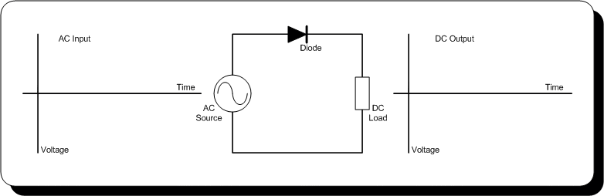
Working of Half-Wave Rectifier (ANIMATION)

Slide 47
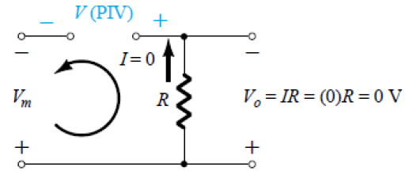
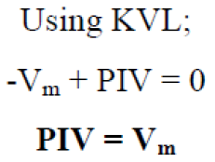
Diodes – Rectifier Circuits

Slide 48
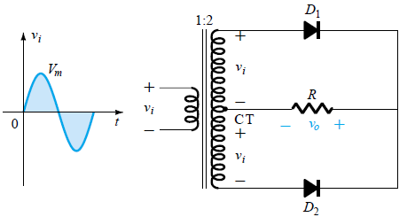
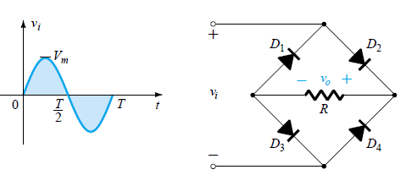
Diodes – Rectifier Circuits
2. Full-Wave Rectifier Circuits
(a) Center-Tapped (CT) Full-Wave Rectifier (b) Full-Wave Bridge Rectifier
Fig. (a) Center-Tapped (CT) Full-Wave Rectifier
Fig. (b) Full-Wave Bridge Rectifier

Slide 49
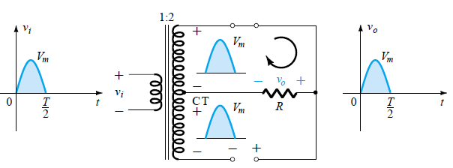
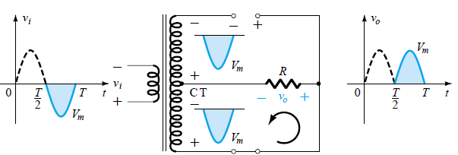
Working of Center-Tapped Full-Wave Rectifier
First (+)ve half cycle
First (-)ve half cycle

Slide 50
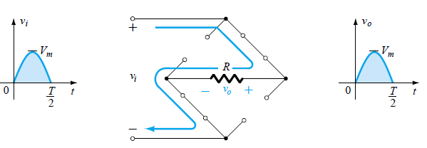
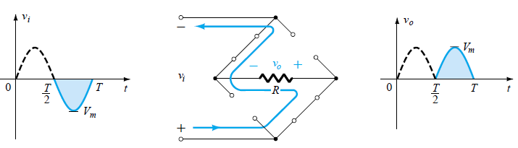
Working of Full-Wave Bridge Rectifier
First (+)ve half cycle
First (-)ve half cycle

Slide 51
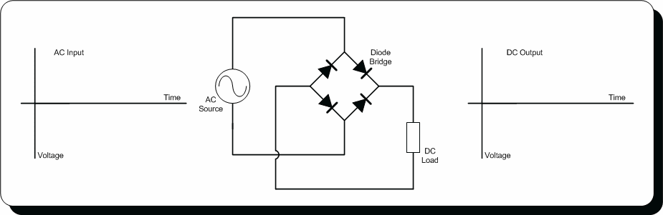
Working of Full-Wave Bridge Rectifier (ANIMATION)

Slide 52
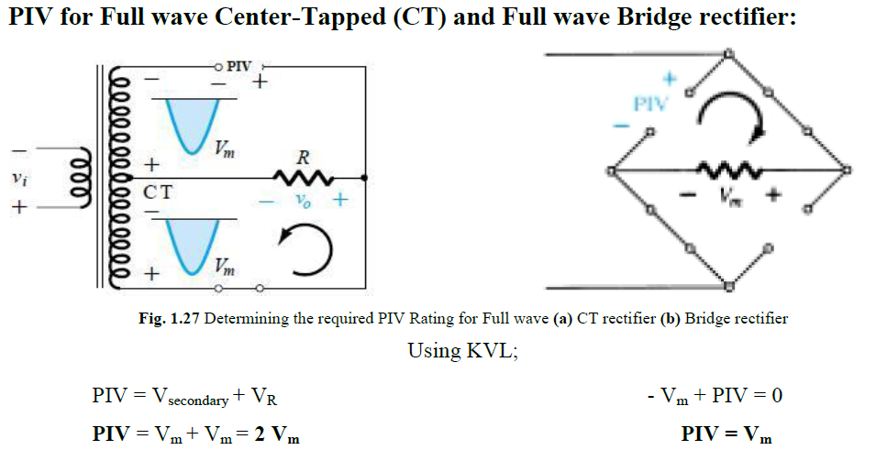
Diodes – Rectifier Circuits

Slide 53
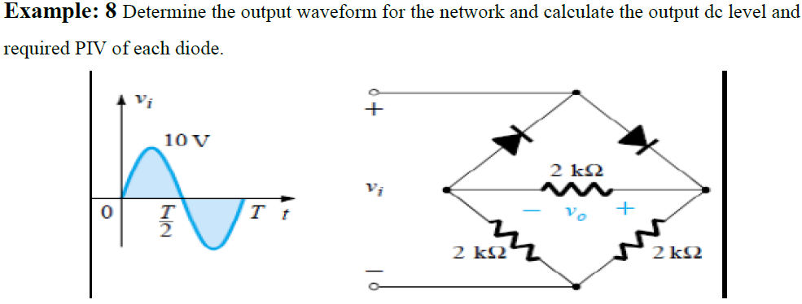
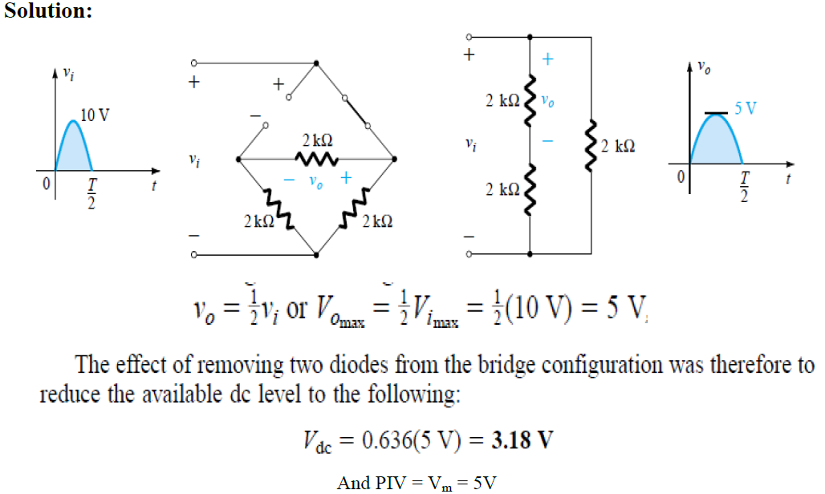
Example from Text Book

Slide 54
Daily Quiz
RMS load current of HWR is…………………
(I_{m}/2)
The average load voltage of HWR is ……….
(V_{m}/ π)
The ripple factor of HWR is…………………
(1.21)
The average load voltage of FWR is ………….
(2V_{m}/π)
The ripple factor of FWR is …………………….
(0.48)

Slide 55
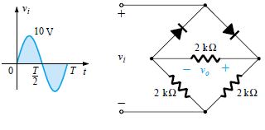
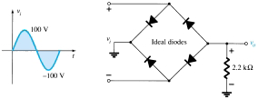
Weekly Assignment
Long Answer type Questions:
Q.1) Explain the Bridge rectifier with diagram also explain Ripple factor (derive) for various rectifiers.
Q.2) Sketch V₀ (determine) and determine the dc voltage and PIV of each diode for Fig. 1 and 2.

Slide 56
Multiple Choice Questions
Q.1) If peak voltage for a HWR circuit is 5 V and diode cut in voltage is 0.7, then peak inverse voltage on diode will be? 5V 4.9V 4.3V 6.7V | Q.4) Efficiency of a centre tapped FWR is…..? 50% 46% 70% 81.2%
Q.2) If the input frequency of a HWR is 100 Hz, then the ripple frequency will be? 150 Hz 200 Hz 100 Hz 50 Hz | Q.5) If the input frequency of a FWR is 100 Hz, then the ripple frequency will be? 150 Hz 200 Hz 100 Hz 50 Hz
Q.3) Diode in small signal positive HWR circuit acts as- Ideal diode Clipper diode Clamper diode Rectifier diode | Q.6) Transformer utilization factor of a centre tapped full wave rectifier is …..? 0.623 0.678 0.693 0.625

Slide 57

Questions from Previous Papers
Define Rectifier. (2010-11, 2012-13)
Draw the circuit diagram of Half Wave Rectifier and explain its operation with output waveforms. (2010-11, 2012-13)
Derive PIV and ripple factor for HWR. (2010-11, 2012-13)
Draw the circuit diagram of Full Wave Rectifier (Centre tapped) and explain its operation with output waveforms. (2001-02, 2004-05, 2009-10, 2011-12, 2012-13)
Draw the circuit diagram of Full Wave Rectifier (Bridge) and explain its operation with output waveforms. (2001-02, 2004-05, 2009-10, 2011-12)
Explain PIV and Ripple factor for FWR (Centre tapped & Bridge). (2001-02,2004-05, 2009-10, 2011-12, 2012-13)
Compare HWR and FWR. (2015-16)

Slide 58
Expected Questions for University Exam
Q.1) What is ripple factor? What is the value of RF for half wave and full wave rectifier?
Q.2) Explain the following with clear diagram:- i) Full wave voltage doubler. ii) Bridge rectifier.
Q.3) Draw the circuit and discuss working of full wave bridge rectifier with suitable input-output waveform. What is PIV of bridge rectifier?

Slide 59
Recap (HWR)
Rectifiers convert AC voltage to pulsating DC voltage.
There are two types of rectifiers:
1. Half Wave Rectifier (HWR)
2. Full Wave Rectifier (FWR)
FWR again divide into two parts
1. Center-Tapped (CT) Full-Wave Rectifier 2. Full-Wave Bridge Rectifier
HWR conducts only during positive half cycles of input ac supply.
Peak Inverse Voltage (PIV) is the maximum voltage appears across the diode during non-conducting or off state.
For HWR, PIV is Vm.
For HWR, efficiency is 41%.
Ripple Factor measures the percentage of ac component in the rectified output.
For HWR, Ripple Factor (γ) 121%.

Slide 60
Recap (FWR)
In Full Wave Rectifier (FWR) circuit current flows through the load line in the same direction for both half cycles (full wave) of input ac voltage.
There are two types of FWR:
1. FWR with Centre Tapped Transformer
2. Full Wave Bridge Rectifier
In Centre Tapped FWR there are two diodes.
In Full Wave Bridge Rectifier there are four diodes.
PIV for Centre Tapped FWR is 2Vm.
PIV for Full Wave Bridge Rectifier is V_{m}.
For FWR, Ripple Factor (γ) 48%.
TUF for Centre Tapped FWR is 69%.
TUF for Full Wave Bridge Rectifier is 81%.

Slide 61
Clipper Circuits
Name of Topic | Duration (Lectures) | (%) Assignment coverage | % of marks in exams
Clippers (Series and Parallel) | 1 | 20 | 5

Slide 62
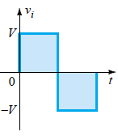
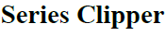
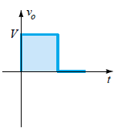
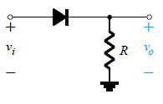
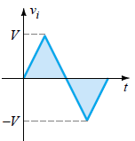
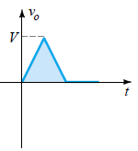
Diodes – Wave-Shaping Circuits
Clipper Circuits

Slide 63
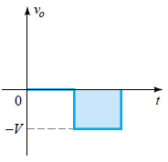
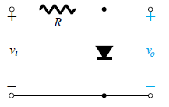
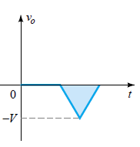
Clipper Circuits

Slide 64
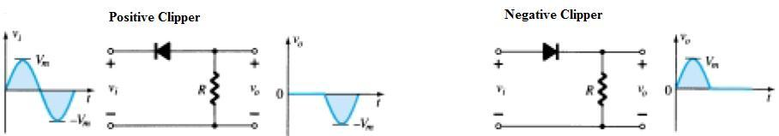
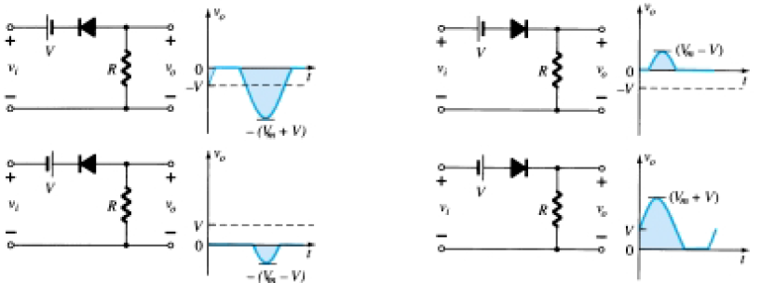
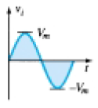
Different Types of Clipping Circuits
Simple Series Clippers (Ideal Diodes)
Biased Series Clippers (Ideal Diodes)

Slide 65
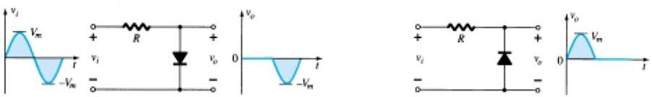
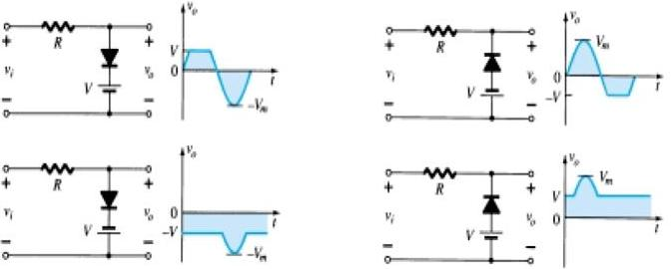
Different Types of Clipping Circuits
Simple Parallel Clippers (Ideal Diode)
Biased Parallel Clippers (Ideal Diode)

Slide 66


Diodes – Wave-Shaping Circuits
Combination Clipper Circuits (2005-06, 2011-12)
Example: Sketch the output

Slide 67


Examples from Text Book

Slide 68


Examples from Text Book

Slide 69


Examples from Text Book

Slide 70


Slide 71

Examples from Text Book

Slide 72
Daily Quiz
The clipper circuit are used for……… some portion of input signal.
(Clip off)
A positive clipper clips off ……..portion of the input waveform.
(Positive)
In a series clipper , for a clipping region, the diode must be in ……………….condition.
(Reverse biased)

Slide 73
Weekly Assignment
Short Answer type Questions:
Q.1) Define series clipper
Q.2) Define parallel clipper

Slide 74
Multiple Choice Questions
Q.1) which circuit is used for obtaining desired output waveform in operational amplifier? Clipper Clamper Peak Amplifier Sample & Hold | Q.4) What happens if the input voltage is higher than reference voltage in a positive clipper? Vout=Vref Vout= DC output voltage Vout=Vin All are correct
Q.2) The clipping level in Op-Amp is decided by …… AC supply voltage Control voltage Reference voltage Input voltage | Q.5) A positive small signal HWR can…… Rectify signals with peak value only Rectify signals with value of few millivolts only Rectify signals with both peak value & down
Q.3) In a positive clipper, diode conducts when- Vin<Vref Vin=Vref Vin>Vref None of the above

Slide 75


Questions from Previous Papers
Explain the clipper circuits and its various types. (2001-02, 2002-03, 2003-04, 2012-13, 2015-16) V.IMP.
2. Sketch i_{R} and V₀ of Fig. 1 for the input shown and draw the V_{o} waveform for the Fig. 2 circuit. (2001-02)
Fig. 1
Fig. 2

Slide 76

Expected Questions for University Exam
Q.1) Write short notes on Clipping circuits.
Q.2) Draw the double ended diode clipper circuit.
Q.3) For the given input waveform to the given circuit, what is the minimum value of the output waveform?

Slide 77
Recap
Clipper or Limiter circuit is used to cut off or eliminate an unwanted section of a waveform.
There are two types of clipper circuits:
1. Series Clipper
2. Shunt or Parallel Clipper
In Series clipper diode is connected in series with load.
In Shunt or parallel clipper diode is connected in series with load.
If the diode is biased then clipper circuits are known as biased clipper otherwise it is known as unbiased clipper circuits.

Slide 78
Zener Diode and Breakdown Mechanism
Name of Topic | Duration (Lectures) | (%) Assignment coverage | % of marks in exams
Zener Diode Breakdown Mechanism (Zener and Avalanche) / Zener diode as Shunt Regulator | 2 | 20 | 5-10

Slide 79


Breakdown Mechanism
Fig. (a) Symbol of Zener Diode
Fig. (b) Characteristics of Zener Diode

Slide 80

Diodes – Zener-Diode Voltage-Regulator Circuits
Zener-Diode Voltage-Regulator Circuits (2009-10, 2015-16)
Zener produces constant output voltage while operating from a variable supply voltage. Such circuits are called voltage regulator.
The Zener diode has a breakdown voltage equal to the desired output voltage.
The resistor limits the diode current to a safe value so that Zener diode does not overheat.
Fig. (a) Zener Diode Voltage- Regulator Circuits
Fig. (b) Characteristics of Zener Diode

Slide 81


Examples from Text Book

Slide 82

Examples from Text Book

Slide 83


Examples from Text Book

Slide 84

Examples from Text Book

Slide 85


Examples from Text Book

Slide 86
Daily Quiz
Zener diode is the back bone of ………… circuit.
(Voltage Regulator)
In the “Zener region” the Zener current ……….
(Vary)
The type of breakdown of V_{Z} less than 5V is………..
(Zener breakdown)

Slide 87
Weekly Assignment
Long Answer type Questions:
Q.1) Explain the Breakdown Mechanism in Zener diode and
Q.2) Explain how Zener diode works as Voltage regulator?

Slide 88
Multiple Choice Questions
Q.1) Zener diode is designed to specifically work in which region without getting damaged? Active region Breakdown region Forward bias Reverse bias | Q.4) When the reverse voltage across the Zener diode is increased …… The value of saturation current increases No effect The value of cut-off potential increases The value of cut-off potential decreases
Q.2) What is the level of doping in Zener diode? Lightly doped Heavily doped Moderately doped No doping | Q.5) The depletion region of the Zener diode is …… Thick Normal Very Thin Very Thick
Q.3) Zener diode is mostly used as …… Half Wave Rectifier Full Wave Rectifier Voltage Regulator LED | Q.6) In normal junctions, the breakdown is same as Zener breakdown? True False

Slide 89
Questions from Previous Papers
Draw the symbol of Zener diode. (2009-10)
Explain breakdown mechanisms. (2009-10, 2013-14, 2015-16)
Compare Zener and Avalanche breakdowns. (2006-07)
Compare Zener and p-n junction diodes. (2010-11)
How Zener works as a voltage regulator or shunt regulator. (2015-16)

Slide 90
Expected Questions for University Exam
Q.1) Explain input output characteristic of zener diode. How zener diode is p-n junction diode?
Q.2) Explain working of zener diode as shunt regulator.

Slide 91
Recap
There are two types of breakdown:
1. Zener Breakdown
2. Avalanche Breakdown
Zener diode is designed for operation in the reverse-breakdown region.
The breakdown voltage is controlled by the doping level.
Breakdown voltage range is 1.8 V to 200 V.
Zener occurs when doping is high.
Avalanche occurs when doping is low.
Zener occurs at lower voltage (< 6V) (due high intensity of electric field 10⁸ V/m).
Avalanche occurs at higher voltage (>6V) (due to avalanche multiplication).
In Zener current increases sharply.
In Avalanche current increases gradually.

Slide 92
Introduction to Display Devices
Name of Topic | Duration (Lectures) | (%) Assignment coverage | % of marks in exams
Light Emitting Diode (LED), O-LED Liquid - Crystal Displays (LCD) | 2 | 20 | 5-10

Slide 93


Light Emitting Diode (LED)
An LED emits light when it is forward biased, which can be in the infrared or visible spectrum.
The forward bias voltage is usually in the range of 2 V to 3 V.
LED Symbol

Slide 94
Materials of LED
S. No. | Material | Symbol | Colour
1 | Gallium Arsenide | GaAs | Infrared (invisible)
2 | Gallium Phosphide | GaP | Red or Green
3 | Gallium Arsenide Phosphide | GaAsP | Red or Yellow

Slide 95
Advantages & Disadvantages of LED
Advantages:
1. Small in size.
2. Fast operating devices. (ON/OFF time is < 1 μs)
3. Light in weight.
4. Long life.
5. Cheap and readily available.
Disadvantages:
1. LED characteristics are affected by temperature.
2. Luminous efficiency of LEDs is low which is about 1.5 lumen/watt.
3. Need large power for the operation compared to normal p-n junction diode.

Slide 96

Applications of LED
1. Seven Segment Display
In the optical devices.
As ON-OFF indicator.

Slide 97

Applications of LED
2. Organic-LED
An OLED is any light emitting diode in which organic layers are responsible for light emission.
Main principle behind OLED technology is electroluminescence.
Electroluminescence is a process in which a material emits light in response to electrical field applied across it.

Slide 98
Features of OLED
Flexibility (in display)
Safe for environment
Light weight because of thin display
Less power consumption
High contrast, brighter and perfect display from all angles

Slide 99

Structure of OLED
Cathode- The cathode injects electrons
into emissive layer.
Emissive layer- This layer is made of
polyfluorene that transport electrons
from the cathode. This is where light is
made.
Conducting layer- This layer is made of
polyaniline that transport "holes" from
the anode.
Anode- It is kept transparent.
Usually made up of Indium tin oxide (ITO)
that removes electrons.
Substrate- The substrate supports the
OLED.

Slide 100

How it Works ??

Slide 101
Working of OLED
A voltage is applied across the anode and cathode
Current flows from cathode to anode through the organic layers
Electrons flow to emissive layer from the cathode
Electrons are removed from conductive layer leaving holes
Holes jump into emissive layer
Electron and hole combine and light emitted

Slide 102
Drawbacks of OLED
Complex fabrication methods
Expensive
Lifespan (Easily damageable)
Water damage
Colour balance issues

Slide 103

OLED Vs Others

Slide 104



Applications of OLED
Major applications of OLED technology are: OLED TV, Mobile phones with OLED screens, Rolltop Laptop.

Slide 105

Liquid Crystal Display
The Liquid Crystals are one of the most fascinating material systems in nature having properties of liquids as well as of a solid crystals.
The different arrangement of these liquid Crystals materials are:
1. Smectic 2. Nematic 3. Cholesteric

Slide 106
Liquid Crystal Display
Advantages:
1. Less power consumption
2. Low cost.
3. Uniform brightness with good contrast.
4. Low operating voltage and current.
Disadvantages:
1. Poor reliability
2. Limited temperature range.
3. Poor visibility in low ambient temperature.
4. Slow speed.
5. Requires an AC drive.

Slide 107
LCDs Applications
7-segment displays.
Calculators, pagers and wrist-watch.
Flat panel display.
Alphanumeric display.

Slide 108
Difference between LEDs and LCDs
S. No. | Parameter | LED | LCD
1 | Power | 10 to 140 μW | 1 to 100 μW
2 | Voltages | 5 V | 3 to 18 V
3 | Temperature Range (⁰C) | -55 to 125 | 0 to 80
4 | Switching Speeds | 1 μs | 100 to 300 ms
5 | Life in hours | 100,000 + | 10,000
6 | Colors | Red, Orange, Yellow, Green | Depends on illumination
7 | Brightness | Good to excellent | Not applicable
8 | Ruggedness | Excellent | Good
9 | Ease of mounting | Excellent | Poor
10 | Applications | 1. 7-segment displays. 2. Indicator 3. Matrix displays | 7-segment displays Calculators, pagers and wrist-watch Flat panel display Alphanumeric display

Slide 109
Daily Quiz
The colour of emitting light in LED depends on ……….
(Material)
The LED emits light when ………………biased.
(Forward)
State applications of LCDs.

Slide 110
Weekly Assignment
Long Answer type Questions:
Q.1) Write Short notes on
i) LED ii) Seven Segment Display iii) LCD
Q.2) Explain the technology “Organic-Light Emitting Diode”.

Slide 111
Multiple Choice Questions
Q.1) The colour of emitted light from LED depends on Its physical dimensions Number of available carriers Type of semiconductor material used No. of recombinations taking place | Q.4) When forward biased, LED emits light because of Recombination of carriers Light generated in breaking covalent bonds Light produced by collisions All are correct
Q.2) The typical value of power consumption of LED is- Around 10mW Between 15 to 20 mW Between 30 to 40 mW Between 35 to 50 mW | Q.5) Electro-optical effect is produced in …… LED LCD O-LED OFC
Q.3) In 7-segment display, how many LEDs are used? 8 7 10 9 | Q.6) LCDs operate from a voltage ranges of …… 3 to 15 V 10 to 15 V 10 V 5 V

Slide 112
Questions from Previous Papers
Explain the Light Emitting Diodes (LED) with neat diagram. (2013-14)
Explain Liquid crystal Displays (LCD) with neat diagram. (2013-14)
Draw the symbol of LED. (2014-15)
Compare LED and LCD. (2014-15)
Compare LED and p-n junction diode. (2012-13)

Slide 113
Expected Questions for University Exam
Q.1) Explain principle of operation of Organic-LED. Also explain how it is different from LED?
Q.2) How can LED be used to make a 7-segment display?
Q.3) Explain principle of operation of LCD.

Slide 114
Recap
An LED emits light when it is forward biased, which can be in the infrared or visible spectrum.
The forward bias voltage is usually in the range of 2 V to 3 V.
The Liquid Crystals are one of the most fascinating material systems in nature having properties of liquids as well as of a solid crystals.
The different arrangement of these liquid Crystals materials are:
1. Smectic 2. Nematic 3. Cholestrics
LED required more power w.r.t. LCD.
LED is faster than LCD.
LED life is more w.r.t. LCD.
LED is a light source while LCD is light reflector.
Mounting of LED is easy w.r.t. LCD.
LED symbol is:

Slide 115
Summary
Semiconductor Diode
Semiconductor Materials
Depletion Layer
V-I Characteristics
Diode Application
Half & Full Wave Rectification
Clippers
Zener Diode as shunt regulator
Breakdown Mechanism: Zener and Avalanche
Display Devices
Liquid Crystal Display (LCD)
Light Emitting Diode (LED) and Organic-LED
Seven Segment Display

Slide 116
Text/Reference Books/YouTube & NPTEL Video Linksbz
Text Books:
1. Robert L. Boylestad/Louis Nashelsky “Electronic Devices and Circuit Theory”, Latest Edition, Pearson Education
2. H S Kalsi, “Electronic Instrumentation”, Latest edition, TMH Publications.
Reference Books:
1. David A. Bell, “Electronic Devices and circuits”, Latest Edition, Oxford University Press.
2. Jacob Millman, C.C. Halkias, Staya bratajit, “Electronic Devices and Circuits”, Latest Edition, TMH Publications.
Suggested links:
https://youtu.be/AuZ00cQ0UrE?list=PLwjK_iyK4LLDBB1E9MFbxGCEnmMMOAXOH
https://youtu.be/aU24RWIgJVs?list=PLwjK_iyK4LLDBB1E
https://youtu.be/c5NeTnp_poA
https://youtu.be/KLGbPgls18k
https://youtu.be/UFJzQH3G1Ko?list=PLVrieKUj5RceFRq5MKy-f-EHdumStFPLt

